Slide 1
COMP 2000
Week 6 - Monday

Slide 2
Last time
What did we talk about last time?
JFrame
Widgets
JButton
JLabel
JTextField
JTextArea
Started layout

Slide 3
Questions?

Slide 4
Project 2

Slide 5
Layout Managers

Slide 6
Layout managers
When you add a widget to a JFrame (or to a JPanel), its layout manager determines how it will be arranged
There are lots of layout managers, but it's worth mentioning four:
BorderLayout
GridLayout
FlowLayout
BoxLayout
Note that we won't talk about BoxLayout, but you should look it up if you get serious about Swing GUIs
BoxLayout makes it easy to arrange widgets in a horizontal or vertical line, with different amount of spacing between widgets

Slide 7
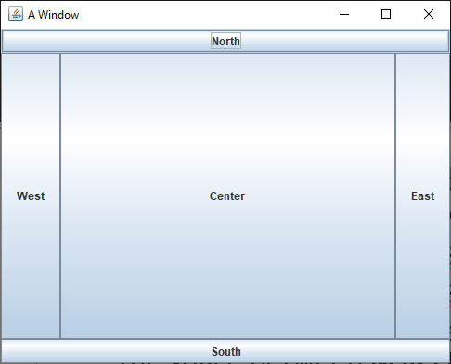
BorderLayout
BorderLayout is the default layout for JFrame
When you add widgets, you can specify the location as one of five regions:
BorderLayout.NORTH stretches the width of the container on the top
BorderLayout.SOUTH stretches the width of the container on the bottom
BorderLayout.EAST sits on the right of the container, stretching to fill all the space between NORTH and SOUTH
BorderLayout.WEST sits on the left of the container, stretching to fill all the space between NORTH and SOUTH
BorderLayout.CENTER sits in the middle of the container and stretches to fill all available space
If you don't specify where you're adding a widget, it adds to CENTER
If you add more than one widget to a region, the new one replaces the old
Unused regions disappear

Slide 8
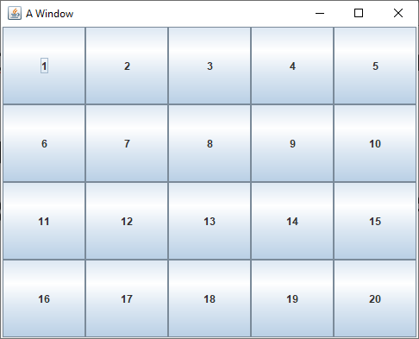
GridLayout
GridLayout allows you to create a grid with a specific number of rows and columns
All the cells in the grid are the same size
As you add widgets, they fill each row
frame.setLayout(new GridLayout(4, 5));
for(int row = 0; row < 4; ++row)
for(int column = 0; column < 5; ++column)
frame.add(new JButton("" + (row * 5 + column + 1)));

Slide 9
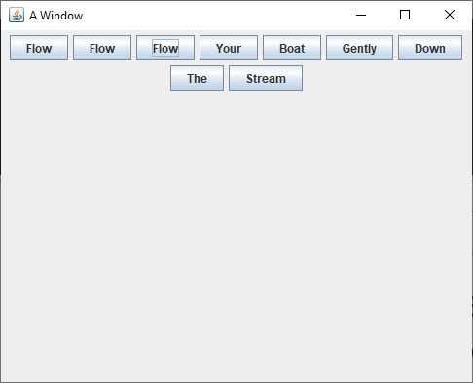
FlowLayout
FlowLayout is the default layout manager for JPanel
Widgets are arranged in centered rows in FlowLayout
If you keep adding widgets to a FlowLayout, they'll fill the current row until there's no more room
Then, they'll flow onto the next row
It's ugly but easy to use
frame.setLayout(new FlowLayout());
frame.add(new JButton("Flow"));
frame.add(new JButton("Flow"));
frame.add(new JButton("Flow"));
frame.add(new JButton("Your"));
frame.add(new JButton("Boat"));
frame.add(new JButton("Gently"));
frame.add(new JButton("Down"));
frame.add(new JButton("The"));
frame.add(new JButton("Stream"));

Slide 10
JPanel
A JPanel is an invisible container that:
Acts like a widget in that you can add it to a JFrame (or another JPanel)
Can hold other widgets
Can have its layout customized with a layout manager
What if you have a BorderLayout and you want the EAST region to contain widgets arranged with a GridLayout?
Easy: you create a JPanel, set its layout manager to GridLayout, add it to the EAST region, then add widgets to the JPanel

Slide 11
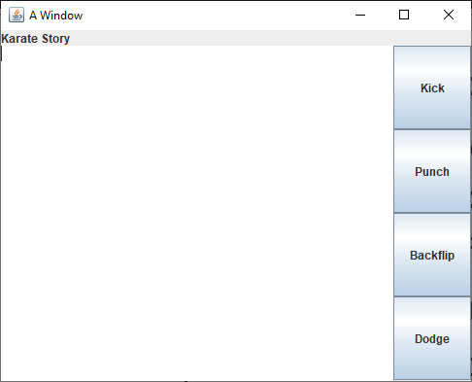
Complicated layouts
For complicated layouts
Sketch out what you want it to look like
Use BorderLayouts to give components a spatial relationship
Nest JPanels inside of JPanels (inside of JPanels…) if you need to
Use GridLayouts whenever you want to have a grid
Be patient: it's hard to get it right the first time
JPanel buttonPanel = new JPanel(new GridLayout(4,1));
buttonPanel.add(new JButton("Kick"));
buttonPanel.add(new JButton("Punch"));
buttonPanel.add(new JButton("Backflip"));
buttonPanel.add(new JButton("Dodge"));
frame.add(buttonPanel, BorderLayout.EAST);
frame.add(new JLabel("Karate Story"), BorderLayout.NORTH);
frame.add(new JTextArea(), BorderLayout.CENTER);

Slide 12
Calculator example
Make the GUI for a calculator
Title the JFrame "Calculator"
Text field at the top giving the current value
Grid of 16 buttons (0-9, ., +, -, *, /, Enter)

Slide 13
Action Listeners

Slide 14
Making buttons do things
We have added JButtons to JFrames, but those buttons don't do anything
When clicked, a JButton fires an event
We need to add an action listener to do something when that event happens
A CLI program runs through loops, calls methods, and makes decisions until it runs out of stuff to do
GUIs usually have this event-based programming model
They sit there, waiting for events to cause methods to get called

Slide 15
ActionListener interface
What can listen for a JButton to click?
Any object that implements ActionListener
ActionListener is an interface like any other with a single abstract method in it:
void actionPerformed(ActionEvent e);
We need to write a class with such a method
We will rarely need to worry about the ActionEvent object
But it does have a getSource() method that will give us the Object (often a JButton) that fired the event

Slide 16
Anonymous inner classes
Now, we get to something tricky
It's possible to create a class on the fly, right in the middle of other code
Consider the following interface:
We can create, in the middle of other code, a class that implements NoiseMaker, like this:
public interface NoiseMaker {
String makeNoise();
}
NoiseMaker maker = new NoiseMaker() {
public String makeNoise() {
return "Yowza!";
}
};

Slide 17
Anonymous inner classes continued
System.out.println("Minding my business..."); // normal code
NoiseMaker maker = new NoiseMaker() { // create a class
public String makeNoise() {
return "Yowza!";
}
};
What the hell is that?
Aren't we instantiating an interface, which is impossible?
No, this makes a new, unnamed class that implements an interface or extends a parent class, on the fly, at the same moment you're allocating it

Slide 18
Adding an action listener
The reason we brought up anonymous inner classes is that we can use this syntax to make an ActionListener object right when we need it, for a button
It's ugly, but it works
JButton button = new JButton("Push me!");
button.addActionListener(new ActionListener() {
public void actionPerformed(ActionEvent e) {
button.setText("Ouch!"); // arbitrary code
}
}); // ugly: parenthesis for end of method call

Slide 19
Things you might do in an action listener
Call arbitrary methods
setText() sets the text on many widgets
getText() gets the text from widgets so you can do something with it
Both setText() and getText() apply to:
JButton
JLabel
JTextField
JTextArea
setIcon() sets the icon on many widgets
JButton
JLabel
setEnabled() can be used to enable and disable buttons

Slide 20
Java 8 style
Before Java 8, we only had two choices:
Make a whole class that implements ActionListener and might have to do different actions based on which button fired the event
Make a separate anonymous inner class for every single button, each doing the action for that button
Java 8 adds something called lambdas which actually make anonymous inner classes too, but the syntax is much nicer
Java 8 style:
JButton button = new JButton("Push me!");
button.addActionListener(e -> button.setText("Ouch!"));

Slide 21
More on Java 8 style
An interface with only a single method in it (like ActionListener) is called a functional interface
Java 8 lets us instantiate functional interface by filling out the method:
(Type1 arg1, Type2 arg2, …) -> { /* method body */ }
But if it's possible for the compiler to infer the argument types, they don't have to be written
If you only have a single argument, you don't need parentheses
And if you only have a single line in your method body, you don't need braces
Multi-line example:
JButton button = new JButton("Push me!");
button.addActionListener(e -> {
button.setText("Ouch!");
button.setEnabled(false);
});

Slide 22
Weird rules
Using lambdas looks cleaner, but the same anonymous inner classes are being created
When you write code in the method of an anonymous inner class
You can refer to member variables and methods in the anonymous inner class (if any)
You can refer to member variables and methods in the surrounding object (even private ones)
You can generally read the values of local variables, but you cannot change them
Don't worry too much about all this
Just write your action listeners and come see me if you have problems

Slide 23
Make the calculator work
Using this information about action listeners, we should be able to make calculator GUI we created functional
Buttons 0-9 and . should add the appropriate symbol to the display JTextField
Buttons +, -, *, and /
Should parse what's in the JTextField into a double and store it in a member variable
Store the appropriate operation in a member variable (maybe as a char?)
Should clear the JTextField
Button =
Should parse what's in the JTextField into a double
Perform the operation that was stored earlier with this value and the value stored earlier
Should put the result back in the JTextField

Slide 24
Upcoming

Slide 25
Next time…
Finish calculator example
Mouse listeners
Playing sounds
Menus

Slide 26
Reminders
Keep reading Chapter 15
Keep working on Project 2

